Slide 1
Introduction to R & data
Part II: Modern R with tidyverse

Slide 2
Data science workflow
Tidy data ensures that further processing can be done efficiently, and reproducibly.
Tidy data is easy to manipulate, model, and visualize.

Slide 3
Tidy data
Each variable is a column and contains values
Each observation is a row
Each type of observational unit forms a table
Patient | Temp | Med_A | Temp_A | Med_B | Temp_B
122030 | 37.0 | 300 | 37.1 | NA | NA
122021 | 38.2 | 200 | 38.1 | 85 | 36.5
124500 | 38.1 | 300 | 38.0 | NA | NA
126098 | 39.1 | NA | NA | 100 | 36.8

Slide 4



Tidy data
multiple observations per row
values in column names
Each variable is a column and contains values
Each observation is a row
Each type of observational unit forms a table
Patient | Temp | Med_A | Temp_A | Med_B | Temp_B
122030 | 37.0 | 300 | 37.1 | NA | NA
122021 | 38.2 | 200 | 38.1 | 85 | 36.5
124500 | 38.1 | 300 | 38.0 | NA | NA
126098 | 39.1 | NA | NA | 100 | 36.8

Slide 5




Tidy data
ID no longer unique per row (but can still be used to collect all info on single patient)
Patient | Temp | Treatment | Dose
122030 | 37.0 | None | NA
122030 | 37.1 | A | 300
122021 | 38.2 | None | NA
122021 | 38.1 | A | 200
122021 | 36.5 | B | 85
124500 | 38.1 | None | NA
124500 | 38.0 | A | 300
126098 | 39.1 | None | NA
126098 | 36.8 | B | 100
Time series (order) lost (so make sure this is explicit)

Slide 6
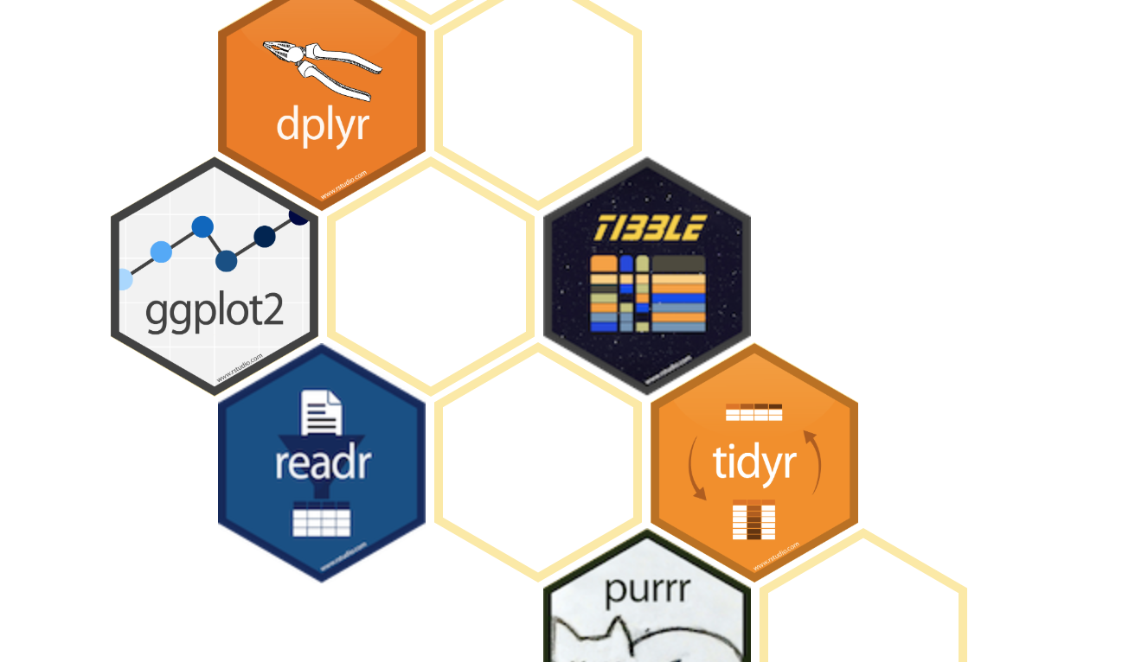
Tidyverse
Modern R for data science
Notes:
Recently developed
Fast adoption by community
Integration with RStudio
Dev by Wickham
- Collection of packages
Everyone can make extensions to the tidyverse
dplyr and ggplot2 are the most well known packages
Easy to switch between base R and tidyverse

Slide 7
"The tidyverse is an opinionated collection of R packages designed for data science. All packages share an underlying design philosophy, grammar, and data structures."
– tidyverse.org (2018)
Notes:
Discuss
Base R is confusing/old, non-intuitive -> tidyverse introduces intuitive functions
Different developers and historical inconsistencies -> tidyverse has a shared grammar
"R is an old language, and some things that were useful 10 or 20 years ago now get in your way. It’s difficult to change base R without breaking existing code, so most innovation occurs in packages."
Tidyverse packages connect and ease the workflow

Slide 8
Tidyverse: connecting packages for every step
Notes:
“Tidyverse packages are intended to make statisticians and data scientists more productive by guiding them through workflows that facilitate communication, and result in reproducible work products. Fundamentally, the tidyverse is about the connections between the tools that make the workflow possible.”

Slide 9

Learn tidyverse
R for Data Science (book); freely available on r4ds.had.co.nz/
ggplot2 (book)
cheatsheets www.rstudio.com/resources/cheatsheets/

Slide 10
Your afternoon roadmap
A short explanation on screen (~15 minutes)
Exercises in a document on your computer (~45 minutes)
2-3 basic exercises
optional exercises, for further practice
recommended reading, for some extra insight into Tidyverse
We will work with a new data set
The exercises are presented in Rmarkdown format.

Slide 11
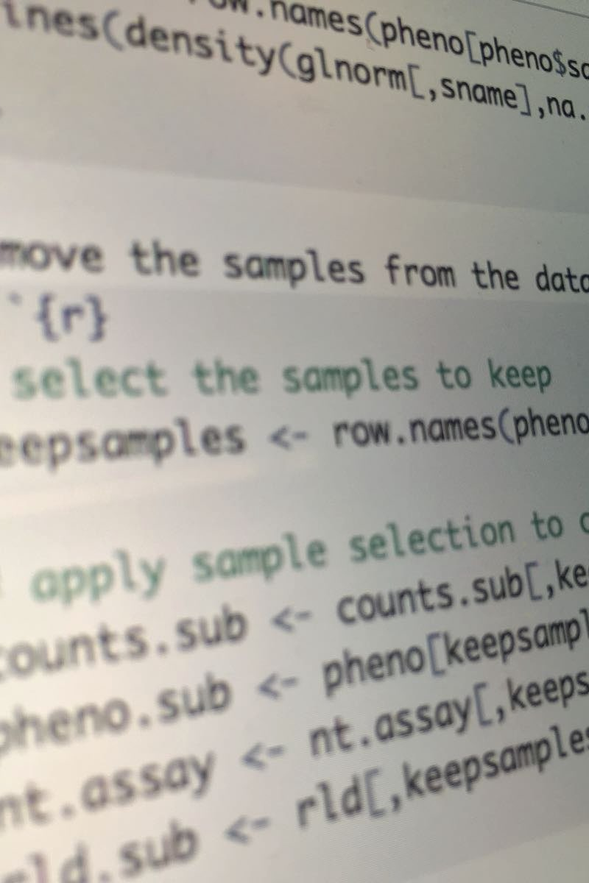
Your afternoon roadmap
Introduction to tidyverse, Rmarkdown, and tibble.
Load and save data with readr
[break]
Data visualisation with ggplot
[break]
Data transformation with tidyr and dplyr

Slide 12
Console, Scripts and Rmarkdown
Console | Code execution | -
Script | Code | Extension: .R (example_script.R)
Rmarkdown | Code + Narrative | Extension: .Rmd (example_report.Rmd)

Slide 13

From code to document
Turn your analyses into high quality documents with Rmarkdown
Combine code with narrative (R with markdown)
Turn your analyses into high quality documents, reports, presentations and dashboards.
… or your note book.

Slide 14
Markdown
# title
Some text about your project
## Section
More text about your project
```{r}
max(iris$Petal.Length)
min(iris$Petal.Length)
```

Slide 15
Rmarkdown: demo

Slide 16
Exercise: open the exercise Rmarkdown
1. RStudio > File > Open Project > introduction-to-R-and-data-github.Rproj
2. From the ‘files’ menu (bottom right), select modernR_exercises.Rmd
3. Update the header information with your name!

Slide 17
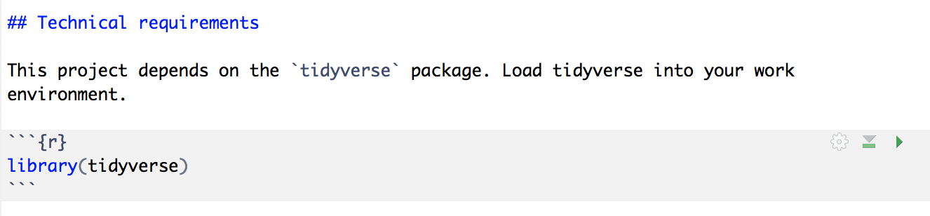

Run the first code chunk!
> library(tidyverse)
── Attaching packages ─────────────────────── tidyverse 1.2.1 ──
✔ ggplot2 3.1.0 ✔ purrr 0.3.0
✔ tibble 2.0.1 ✔ dplyr 0.7.8
✔ tidyr 0.8.2 ✔ stringr 1.4.0
✔ readr 1.3.1 ✔ forcats 0.3.0
── Conflicts ────────────────────────── tidyverse_conflicts() ──
✖ dplyr::filter() masks stats::filter()
✖ dplyr::lag() masks stats::lag()

Slide 18
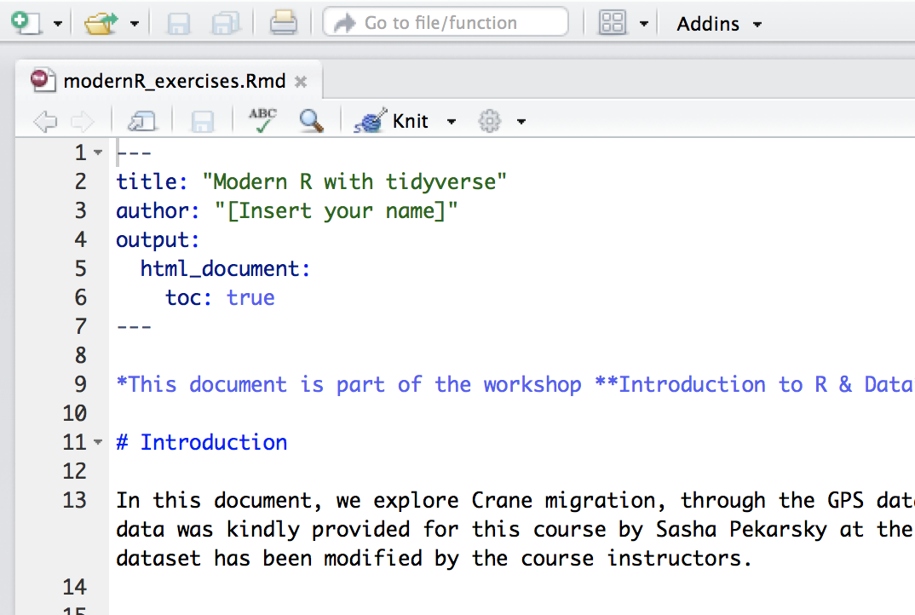

All done? Time to knit!

Slide 19

package: Tibble
"Tibbles are data frames, but they tweak some older behaviours to make life a little easier.”
- Hadley Wickham

Slide 20
Tibbles
> tibble(a = 1:26, b = letters)
# A tibble: 26 x 2
a b
<int> <chr>
1 1 a
2 2 b
3 3 c
4 4 d
5 5 e
6 6 f
7 7 g
8 8 h
9 9 i
10 10 j
# ... with 16 more rows

Slide 21
Tibbles: from data.frame to tibble
> as_tibble(iris)
# A tibble: 150 x 5
Sepal.Length Sepal.Width Petal.Length Petal.Width Species
<dbl> <dbl> <dbl> <dbl> <fct>
1 5.10 3.50 1.40 0.200 setosa
2 4.90 3.00 1.40 0.200 setosa
3 4.70 3.20 1.30 0.200 setosa
4 4.60 3.10 1.50 0.200 setosa
5 5.00 3.60 1.40 0.200 setosa
6 5.40 3.90 1.70 0.400 setosa
7 4.60 3.40 1.40 0.300 setosa
8 5.00 3.40 1.50 0.200 setosa
9 4.40 2.90 1.40 0.200 setosa
10 4.90 3.10 1.50 0.100 setosa
# ... with 140 more rows

Slide 22
Tibbles: from tibble to data.frame
> iris_tibble <- as_tibble(iris)
> as.data.frame(iris_tibble)
Sepal.Length Sepal.Width Petal.Length Petal.Width Species
1 5.1 3.5 1.4 0.2 setosa
2 4.9 3.0 1.4 0.2 setosa
3 4.7 3.2 1.3 0.2 setosa
4 4.6 3.1 1.5 0.2 setosa
5 5.0 3.6 1.4 0.2 setosa
6 5.4 3.9 1.7 0.4 setosa
7 4.6 3.4 1.4 0.3 setosa
8 5.0 3.4 1.5 0.2 setosa
9 4.4 2.9 1.4 0.2 setosa
10 4.9 3.1 1.5 0.1 setosa
11 5.4 3.7 1.5 0.2 setosa
12 4.8 3.4 1.6 0.2 setosa
13 4.8 3.0 1.4 0.1 setosa
14 4.3 3.0 1.1 0.1 setosa
15 5.8 4.0 1.2 0.2 setosa
16 5.7 4.4 1.5 0.4 setosa
17 5.4 3.9 1.3 0.4 setosa
18 5.1 3.5 1.4 0.3 setosa
19 5.7 3.8 1.7 0.3 setosa
20 5.1 3.8 1.5 0.3 setosa
21 5.4 3.4 1.7 0.2 setosa
22 5.1 3.7 1.5 0.4 setosa
23 4.6 3.6 1.0 0.2 setosa
24 5.1 3.3 1.7 0.5 setosa

Slide 23

Load and save data
The basics of readr

Slide 24
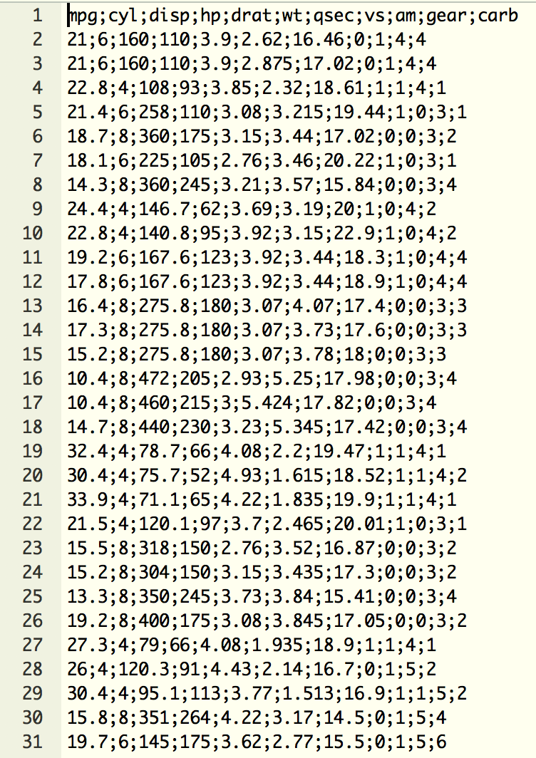
Flat data files
Most common format: Comma-separated values (CSV)
Delimiter-separated values (also stored as CSV)
Common delimiters:
comma ,
semicolon ;
tab \t

Slide 25
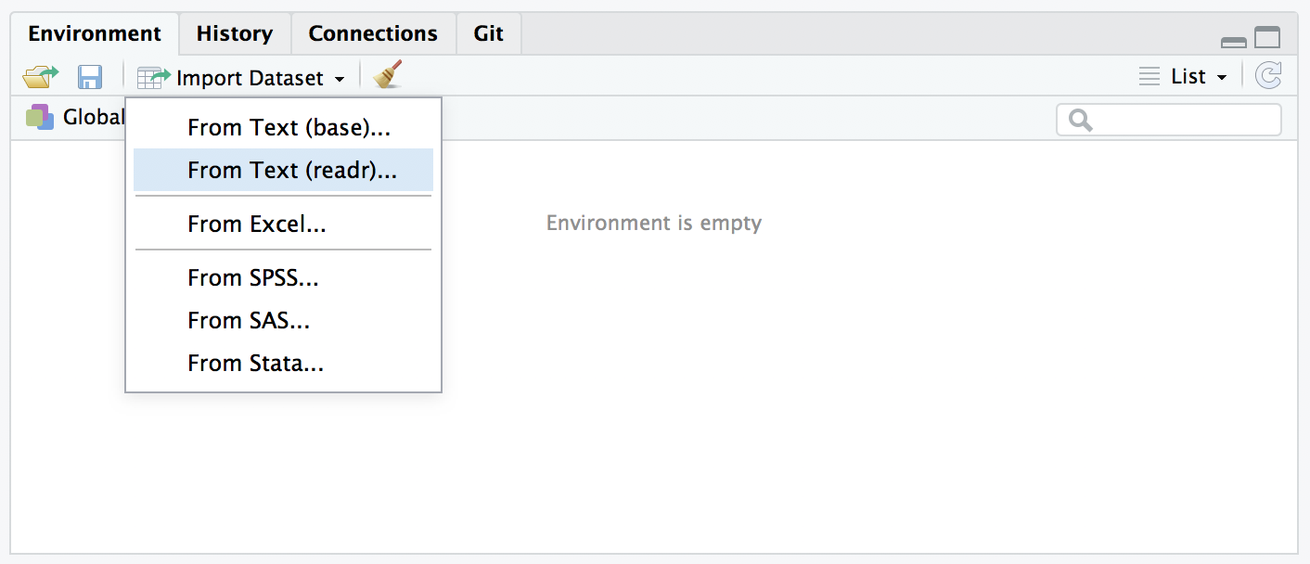

Load data by using buttons

Slide 26
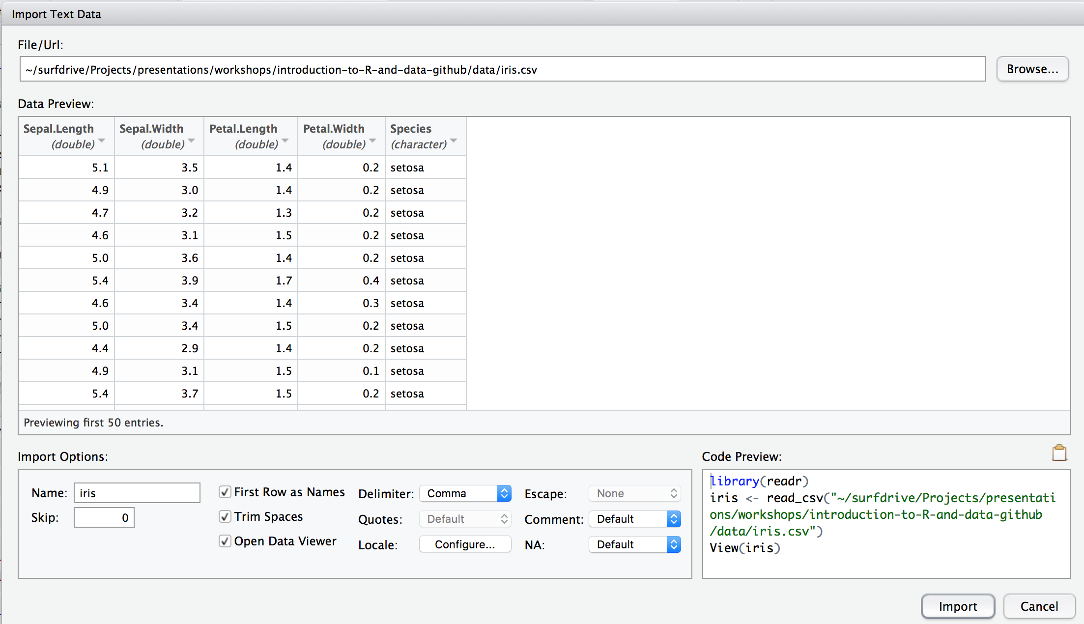


Load data by using buttons

Slide 27

Read flat files
> library(readr)
> data_iris <- read_delim("data/iris.csv", delim=',')

Slide 28
Read flat files
> library(readr)
> data_iris <- read_delim("data/iris.csv", delim=',')
Parsed with column specification:
cols(
Sepal.Length = col_double(),
Sepal.Width = col_double(),
Petal.Length = col_double(),
Petal.Width = col_double(),
Species = col_character()
)

Slide 29
Read flat files
> library(readr)
> data_iris <- read_csv("data/iris.csv")
Parsed with column specification:
cols(
Sepal.Length = col_double(),
Sepal.Width = col_double(),
Petal.Length = col_double(),
Petal.Width = col_double(),
Species = col_character()
)

Slide 30
Exercise dataset
GPS data from 39 tagged individual cranes during fall migration of 2017
Courtesy of Sasha Pekarsky at the Hebrew University of Jerusalem, Israel
In the ‘data’ folder of your course materials.
Notes:
Yes Jonathan, cranes are birds.

Slide 31
Exercises
Please do basic exercises 1-I and 1-II.
Time left? Opt for an optional exercise, or explore the recommended reading!

Slide 32

Data visualisation
Create eye candy with ggplot2

Slide 33
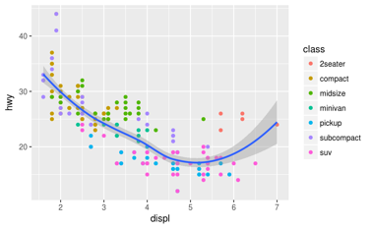
Examples of plots with R (and ggplot2)

Slide 34
Data visualisation with ggplot2
ggplot2 is an extremely popular data visualisation package for R
Simple syntax, easy to learn, nice plots
Developed and maintained by Hadley Wickham
Based on the book: The Grammar of Graphics (Wilkinson, 2005)

Slide 35
The grammar of graphics
Data | The variables in a tibble or data.frame
Aesthetics | x- and y-axis, colour, size, alpha, shape
Geometries | point, line, bar, histogram
Source: https://www.youtube.com/watch?v=uiTc55clwuA

Slide 36
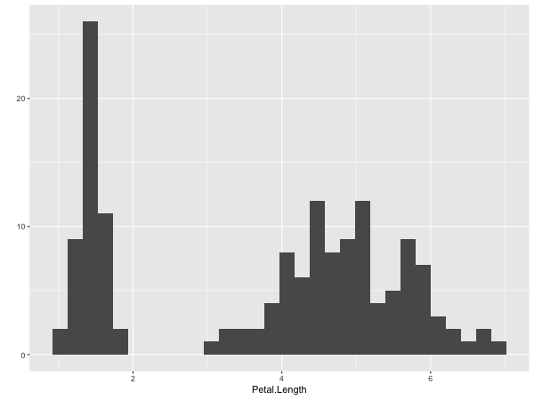
Quick plots
> qplot(Petal.Length, data = iris)

Slide 37
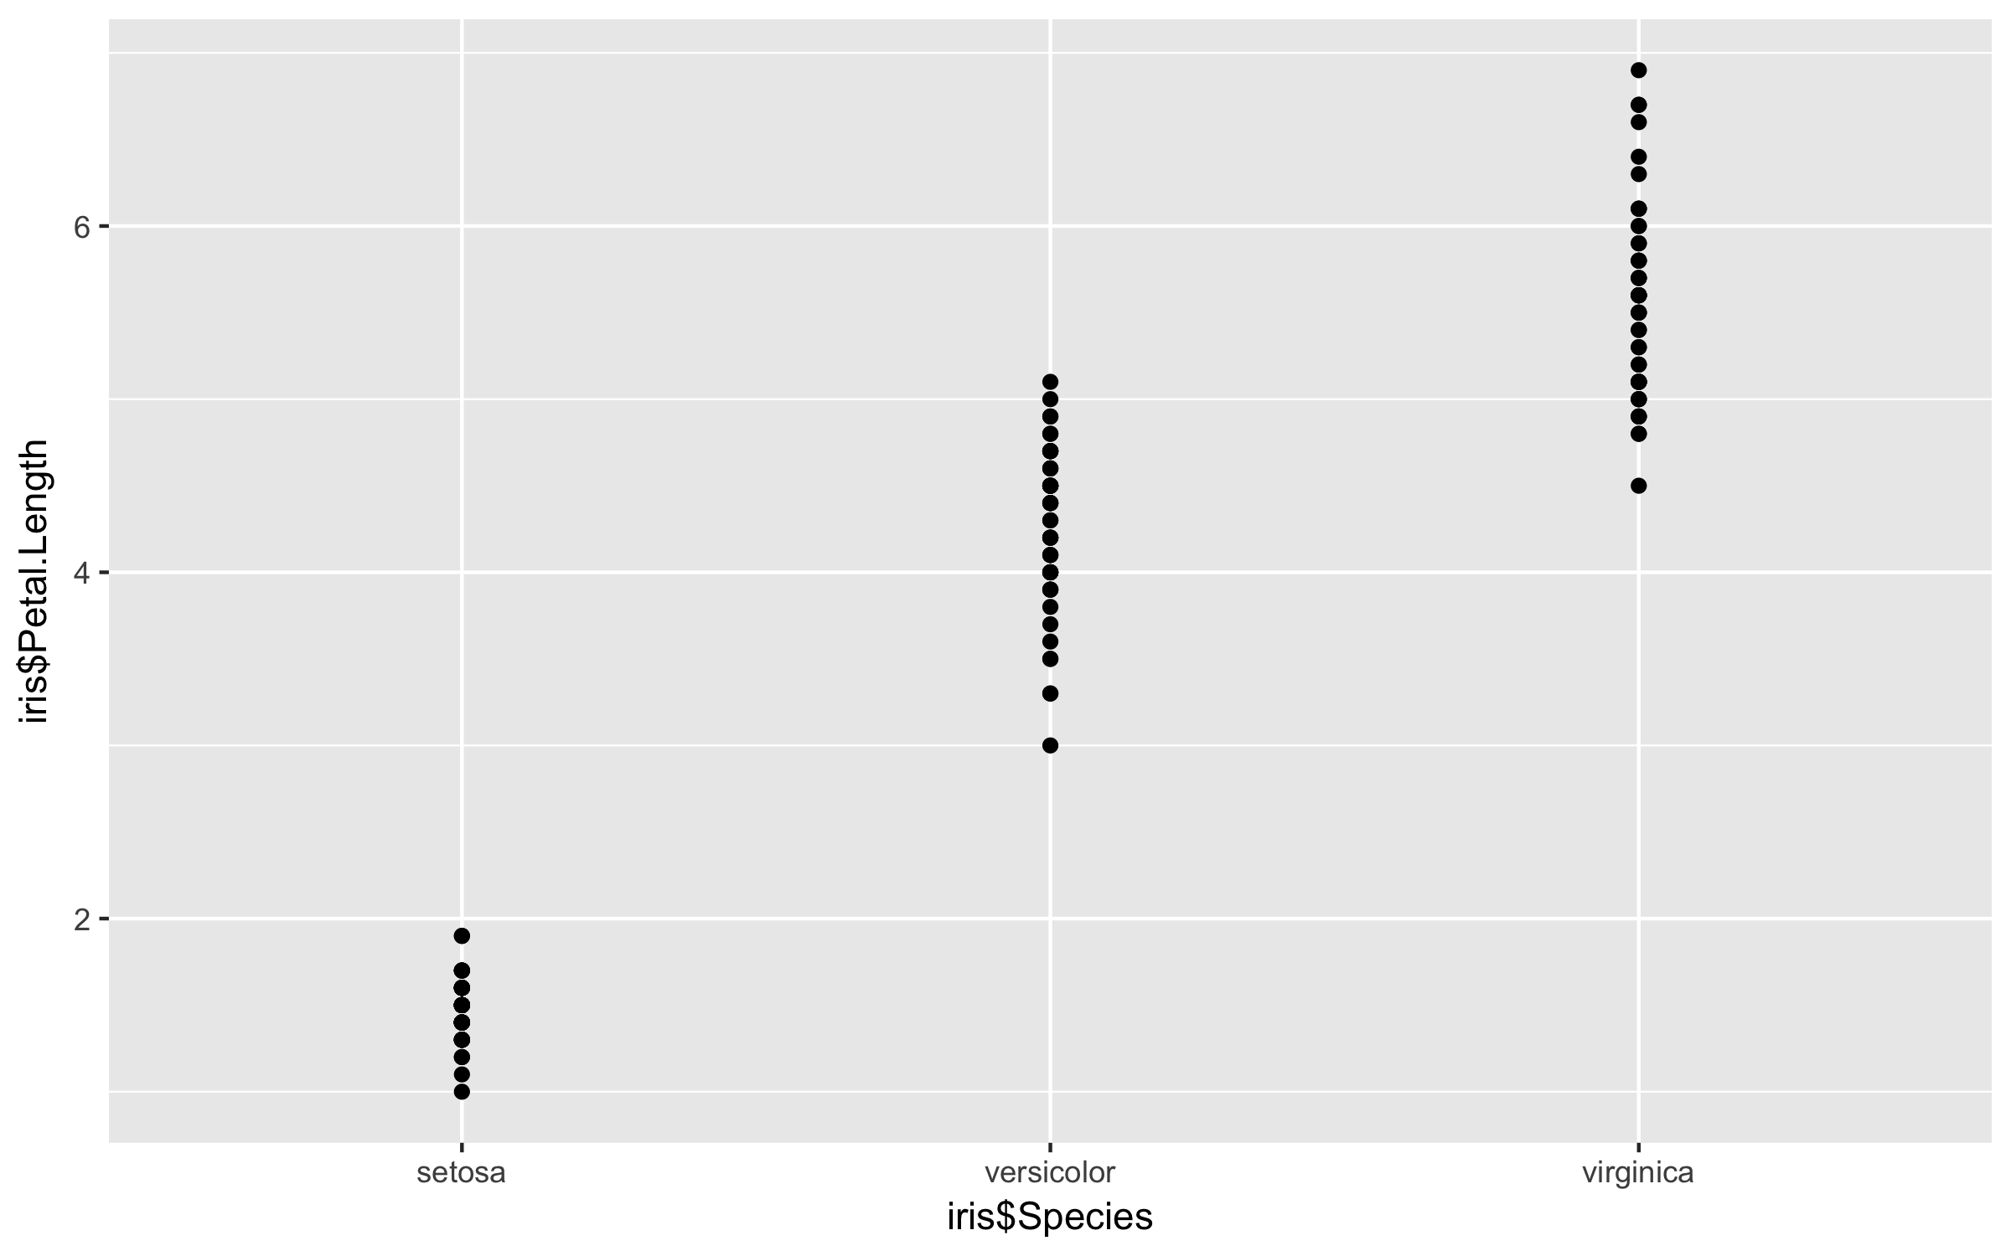
Quick plots
> qplot(Petal.Length, data = iris)
> qplot(Species, Petal.Length, data = iris)

Slide 38
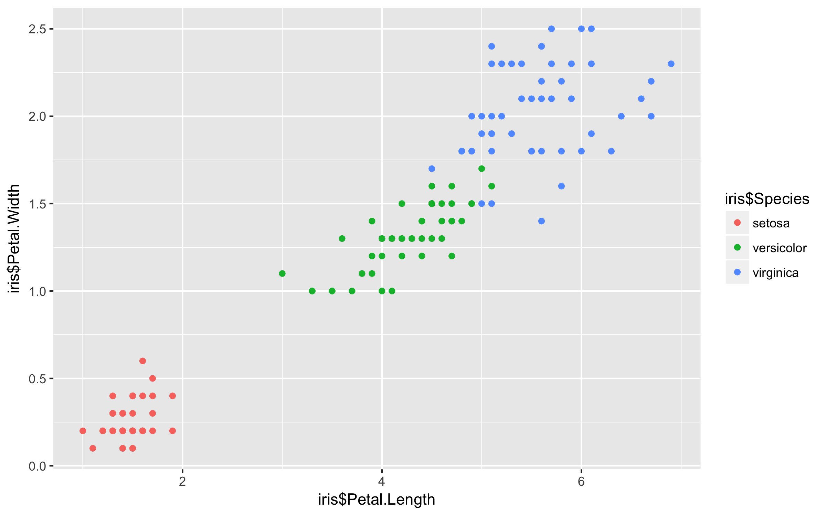
Quick plots
> qplot(Petal.Length, data = iris)
> qplot(Species, Petal.Length, data = iris)
> qplot(Petal.Length, Petal.Width, data = iris, colour=Species)

Slide 39
ggplot (grammar of graphics)

Slide 40

ggplot: Data, aesthetics, geometrics
> ggplot(iris)

Slide 41
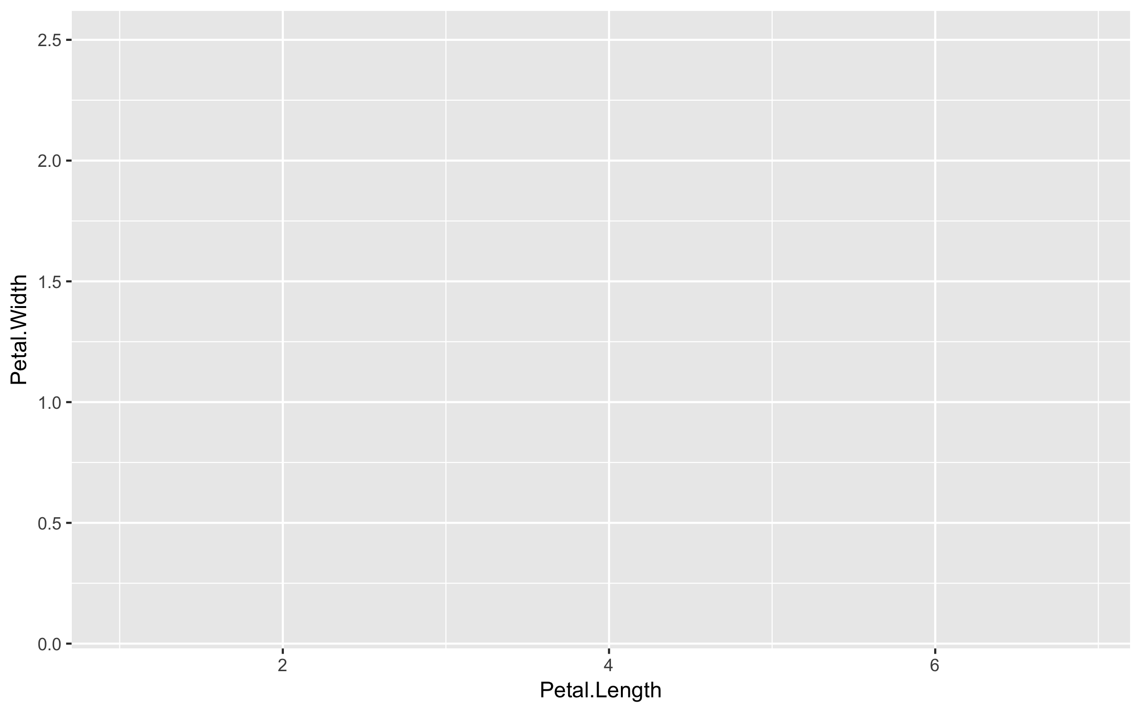
ggplot: Data, aesthetics, geometrics
> ggplot(iris)
> ggplot(iris, aes(x = Petal.Length, y = Petal.Width, colour=Species))

Slide 42
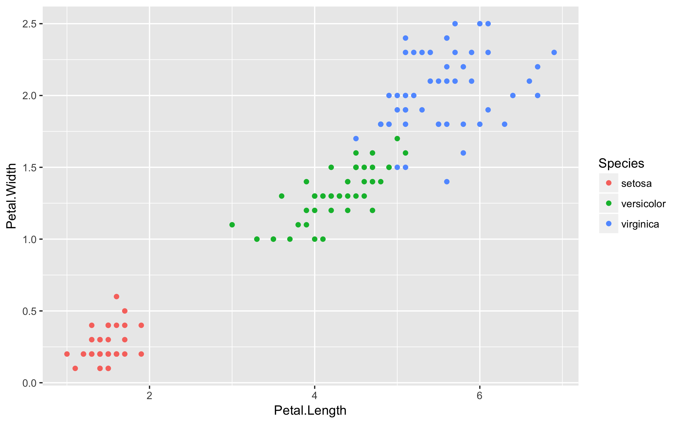
ggplot: Data, aesthetics, geometrics
> ggplot(iris)
> ggplot(iris, aes(x = Petal.Length, y = Petal.Width, colour=Species))
> ggplot(iris, aes(x = Petal.Length, y = Petal.Width, colour=Species)) +
geom_point()

Slide 43
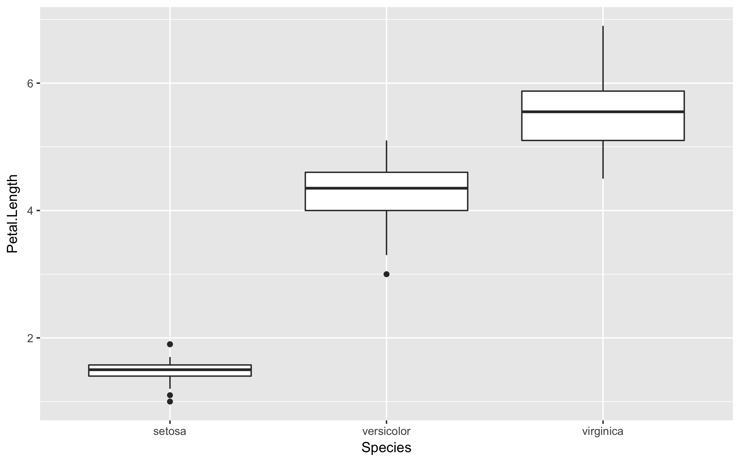
ggplot: Multiple geometric layers
> ggplot(iris, aes(x = Species, y = Petal.Length)) +
geom_boxplot()

Slide 44
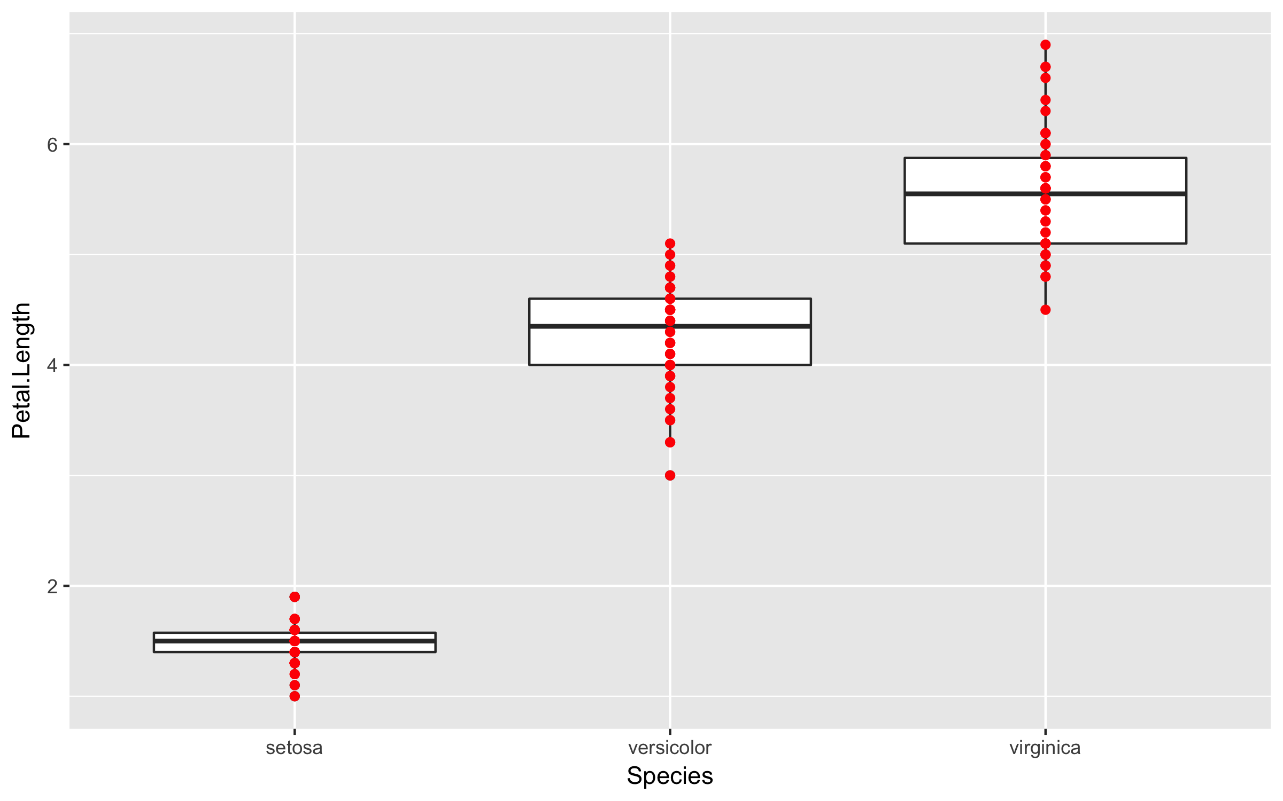
ggplot: Multiple geometric layers
> ggplot(iris, aes(x = Species, y = Petal.Length)) +
geom_boxplot() +
geom_point(colour='red')

Slide 45
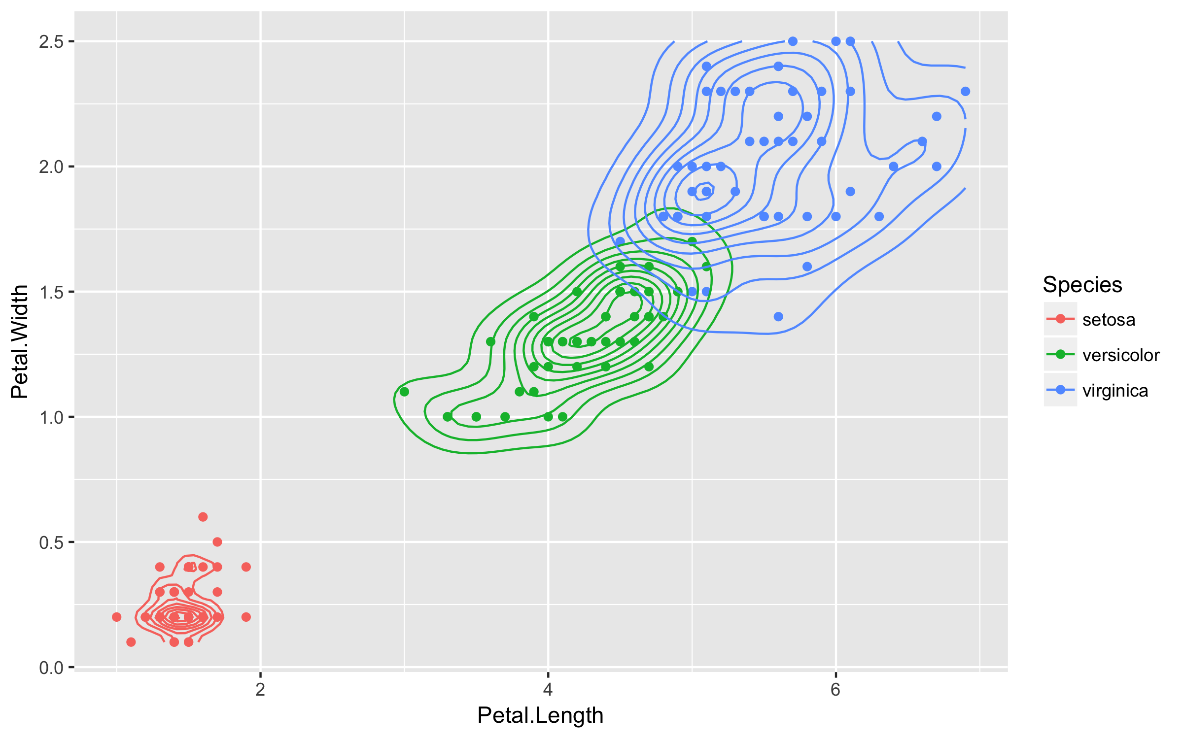
ggplot: Statistical layers
> ggplot(iris, aes(x = Petal.Length, y = Petal.Width, colour=Species)) +
geom_point() +
stat_density_2d()

Slide 46
Exercises
Please do basic exercises 2-I and 2-II.
Time left? Opt for an optional exercise, or explore the recommended reading!

Slide 47

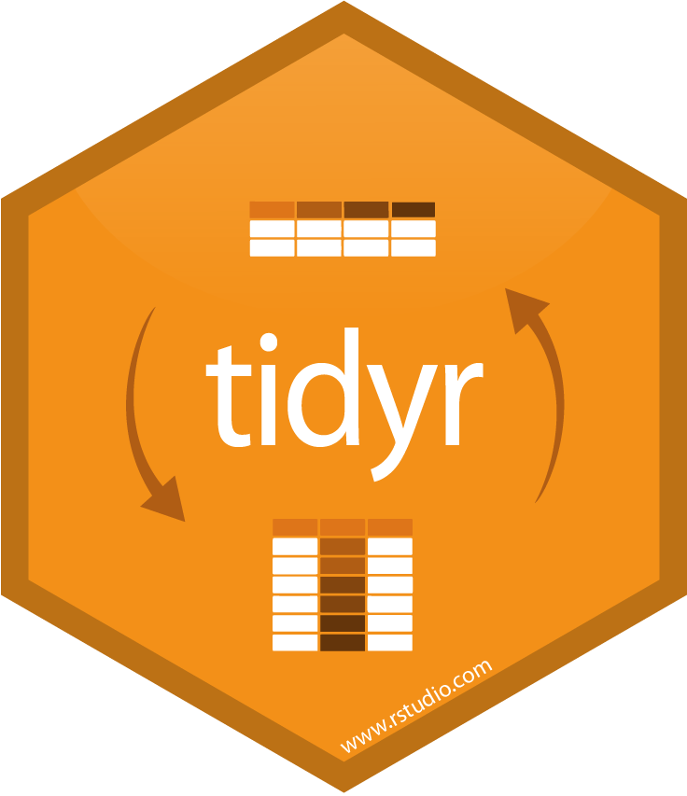
Data transformation
Explore the power of dplyr and tidyr

Slide 48
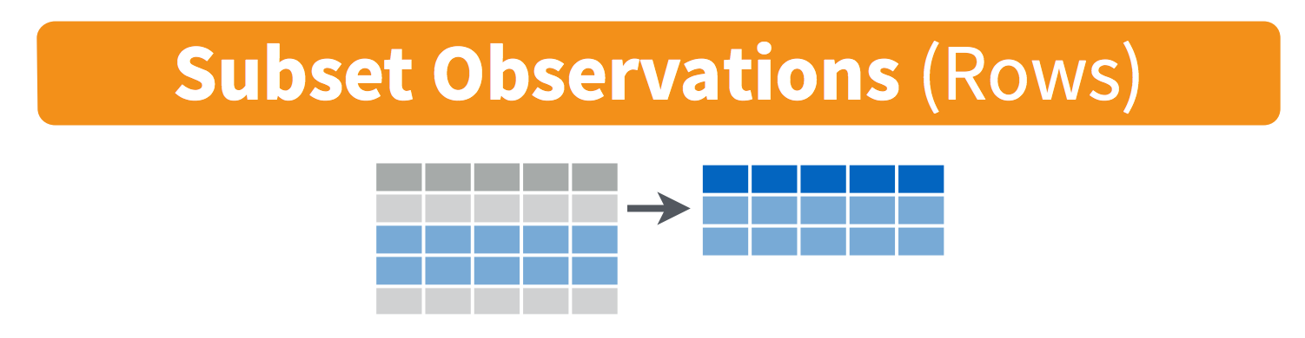
filter()
Notes:
https://jules32.github.io/2016-07-12-Oxford/dplyr_tidyr/

Slide 49
Function: filter()
> filter(iris, Species=="virginica")

Slide 50
Function: filter()
> filter(iris, Species=="virginica")
# A tibble: 50 x 5
Sepal.Length Sepal.Width Petal.Length Petal.Width Species
<dbl> <dbl> <dbl> <dbl> <fct>
1 6.30 3.30 6.00 2.50 virginica
2 5.80 2.70 5.10 1.90 virginica
3 7.10 3.00 5.90 2.10 virginica
4 6.30 2.90 5.60 1.80 virginica
5 6.50 3.00 5.80 2.20 virginica
6 7.60 3.00 6.60 2.10 virginica
7 4.90 2.50 4.50 1.70 virginica
8 7.30 2.90 6.30 1.80 virginica
9 6.70 2.50 5.80 1.80 virginica
10 7.20 3.60 6.10 2.50 virginica
# ... with 40 more rows

Slide 51
Function: filter()
> filter(iris, Species=="virginica", Sepal.Length>= 7.5)

Slide 52
Function: filter()
> filter(iris, Species=="virginica", Sepal.Length>= 7.5)
# A tibble: 6 x 5
Sepal.Length Sepal.Width Petal.Length Petal.Width Species
<dbl> <dbl> <dbl> <dbl> <fct>
1 7.60 3.00 6.60 2.10 virginica
2 7.70 3.80 6.70 2.20 virginica
3 7.70 2.60 6.90 2.30 virginica
4 7.70 2.80 6.70 2.00 virginica
5 7.90 3.80 6.40 2.00 virginica
6 7.70 3.00 6.10 2.30 virginica

Slide 53
Function: filter()
> filter(iris, Species=="virginica", Sepal.Length>= 7.5)
# A tibble: 6 x 5
Sepal.Length Sepal.Width Petal.Length Petal.Width Species
<dbl> <dbl> <dbl> <dbl> <fct>
1 7.60 3.00 6.60 2.10 virginica
2 7.70 3.80 6.70 2.20 virginica
3 7.70 2.60 6.90 2.30 virginica
4 7.70 2.80 6.70 2.00 virginica
5 7.90 3.80 6.40 2.00 virginica
6 7.70 3.00 6.10 2.30 virginica
Same as:
> filter(iris, Species=="virginica" & Sepal.Length>= 7.5)

Slide 54
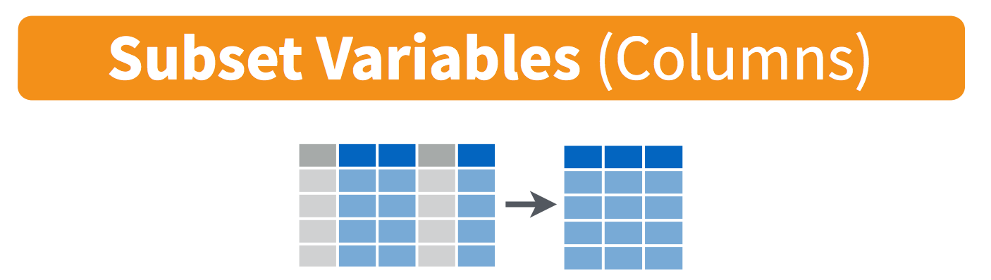
select()
Notes:
https://jules32.github.io/2016-07-12-Oxford/dplyr_tidyr/

Slide 55
Function: select()
> select(iris, Sepal.Length, Sepal.Width, Species)

Slide 56
Function: select()
> select(iris, Sepal.Length, Sepal.Width, Species)
# A tibble: 150 x 3
Sepal.Length Sepal.Width Species
<dbl> <dbl> <fct>
1 5.10 3.50 setosa
2 4.90 3.00 setosa
3 4.70 3.20 setosa
4 4.60 3.10 setosa
5 5.00 3.60 setosa
6 5.40 3.90 setosa
7 4.60 3.40 setosa
8 5.00 3.40 setosa
9 4.40 2.90 setosa
10 4.90 3.10 setosa
# ... with 140 more rows

Slide 57

Function: select()
> select(iris, Sepal.Length, Sepal.Width, Species)
> select(iris, starts_with("Sepal"), Species)

Slide 58
Function: select()
> select(iris, Sepal.Length, Sepal.Width, Species)
> select(iris, starts_with("Sepal"), Species)
# A tibble: 150 x 3
Sepal.Length Sepal.Width Species
<dbl> <dbl> <fct>
1 5.10 3.50 setosa
2 4.90 3.00 setosa
3 4.70 3.20 setosa
4 4.60 3.10 setosa
5 5.00 3.60 setosa
6 5.40 3.90 setosa
7 4.60 3.40 setosa
8 5.00 3.40 setosa
9 4.40 2.90 setosa
10 4.90 3.10 setosa
# ... with 140 more rows

Slide 59
Function: select()
> select(iris, Sepal.Length, Sepal.Width, Species)
> select(iris, starts_with("Sepal"), Species)
> select(iris, -starts_with("Petal"))

Slide 60
Function: select()
> select(iris, Sepal.Length, Sepal.Width, Species)
> select(iris, starts_with("Sepal"), Species)
> select(iris, -starts_with("Petal"))
# A tibble: 150 x 3
Sepal.Length Sepal.Width Species
<dbl> <dbl> <fct>
1 5.10 3.50 setosa
2 4.90 3.00 setosa
3 4.70 3.20 setosa
4 4.60 3.10 setosa
5 5.00 3.60 setosa
6 5.40 3.90 setosa
7 4.60 3.40 setosa
8 5.00 3.40 setosa
9 4.40 2.90 setosa
10 4.90 3.10 setosa
# ... with 140 more rows

Slide 61
Combining functions: the power of piping
%>%
iris %>% filter(Species=="setosa") %>%
select(starts_with("Sepal"), Species) %>%
head()
Sepal.Length Sepal.Width Species
1 5.1 3.5 setosa
2 4.9 3.0 setosa
3 4.7 3.2 setosa
4 4.6 3.1 setosa
5 5.0 3.6 setosa
6 5.4 3.9 setosa

Slide 62
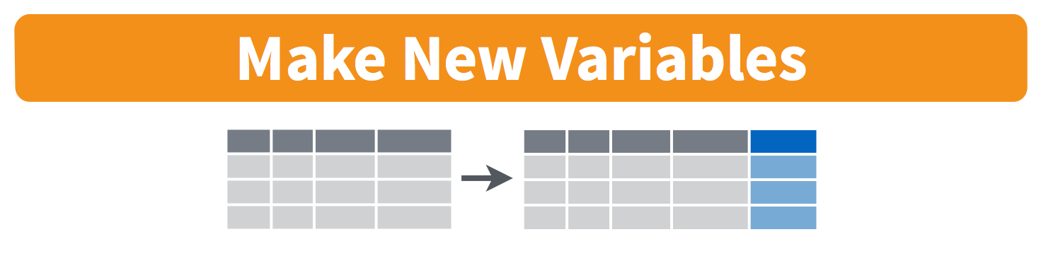
mutate()
Notes:
https://jules32.github.io/2016-07-12-Oxford/dplyr_tidyr/

Slide 63
Function: mutate()
> mutate(iris,
petal_area = pi * Petal.Length/2 * Petal.Width/2)

Slide 64
Function: mutate()
> mutate(iris,
petal_area = pi * Petal.Length/2 * Petal.Width/2)
# A tibble: 150 x 6
Sepal.Length Sepal.Width Petal.Length Petal.Width Species petal_area
<dbl> <dbl> <dbl> <dbl> <fct> <dbl>
1 5.1 3.5 1.4 0.2 setosa 0.220
2 4.9 3 1.4 0.2 setosa 0.220
3 4.7 3.2 1.3 0.2 setosa 0.204
4 4.6 3.1 1.5 0.2 setosa 0.236
5 5 3.6 1.4 0.2 setosa 0.220
6 5.4 3.9 1.7 0.4 setosa 0.534
7 4.6 3.4 1.4 0.3 setosa 0.330
8 5 3.4 1.5 0.2 setosa 0.236
9 4.4 2.9 1.4 0.2 setosa 0.220
10 4.9 3.1 1.5 0.1 setosa 0.118
# ... with 140 more rows

Slide 65
Function: mutate()
> mutate(iris,
# compute the area of a single petal
petal_area = pi * Petal.Length/2 * Petal.Width/2,
# abbreviate the name of the species
Species_abbr = substring(Species, 1, 3)
)

Slide 66
Function: mutate()
> mutate(iris,
# compute the area of a single petal
petal_area = pi * Petal.Length/2 * Petal.Width/2,
# abbreviate the name of the species
Species_abbr = substring(Species, 1, 3)
)
# A tibble: 150 x 7
Sepal.Length Sepal.Width Petal.Length Petal.Width Species petal_area Species_abbr
<dbl> <dbl> <dbl> <dbl> <fct> <dbl> <chr>
1 5.1 3.5 1.4 0.2 setosa 0.220 set
2 4.9 3 1.4 0.2 setosa 0.220 set
3 4.7 3.2 1.3 0.2 setosa 0.204 set
4 4.6 3.1 1.5 0.2 setosa 0.236 set
5 5 3.6 1.4 0.2 setosa 0.220 set
6 5.4 3.9 1.7 0.4 setosa 0.534 set
7 4.6 3.4 1.4 0.3 setosa 0.330 set
8 5 3.4 1.5 0.2 setosa 0.236 set
9 4.4 2.9 1.4 0.2 setosa 0.220 set
10 4.9 3.1 1.5 0.1 setosa 0.118 set
# ... with 140 more rows

Slide 67
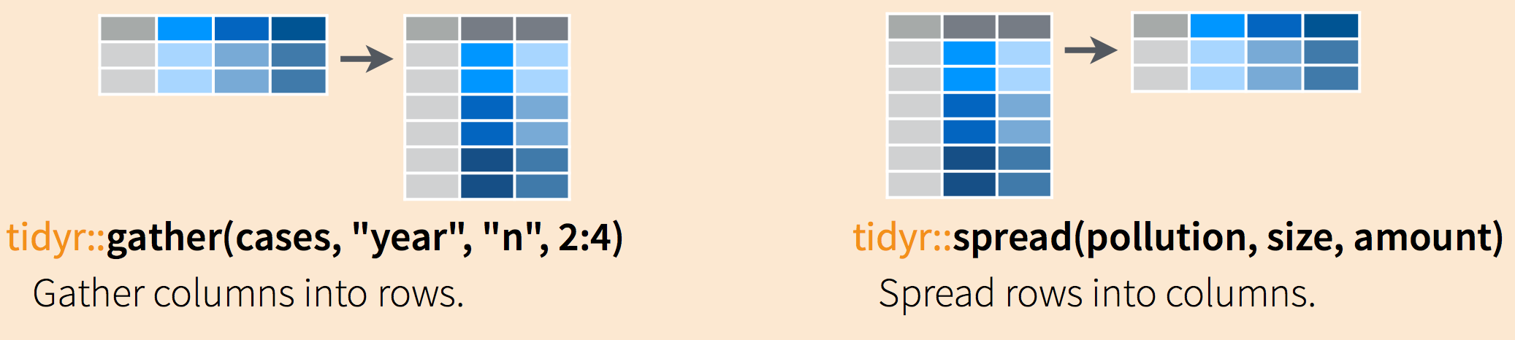
gather() and spread()
Notes:
https://jules32.github.io/2016-07-12-Oxford/dplyr_tidyr/

Slide 68
Wide and long data
# A tibble: 150 x 6
Species observation Petal.Length Petal.Width Sepal.Length Sepal.Width
<chr> <int> <dbl> <dbl> <dbl> <dbl>
1 setosa 1 1.40 0.200 5.10 3.50
2 setosa 2 1.40 0.200 4.90 3.00
3 setosa 3 1.30 0.200 4.70 3.20
4 setosa 4 1.50 0.200 4.60 3.10
5 setosa 5 1.40 0.200 5.00 3.60
6 setosa 6 1.70 0.400 5.40 3.90
7 setosa 7 1.40 0.300 4.60 3.40
8 setosa 8 1.50 0.200 5.00 3.40
9 setosa 9 1.40 0.200 4.40 2.90
10 setosa 10 1.50 0.100 4.90 3.10
# ... with 140 more rows
# A tibble: 600 x 4
Species observation measurement value
<chr> <int> <chr> <dbl>
1 setosa 1 Sepal.Length 5.10
2 setosa 1 Sepal.Width 3.50
3 setosa 1 Petal.Length 1.40
4 setosa 1 Petal.Width 0.200
5 setosa 2 Sepal.Length 4.90
6 setosa 2 Sepal.Width 3.00
7 setosa 2 Petal.Length 1.40
8 setosa 2 Petal.Width 0.200
9 setosa 3 Sepal.Length 4.70
10 setosa 3 Sepal.Width 3.20
# ... with 590 more rows
More information per row
Combines all measurements on a single individual
Necessary to plot matching measurements
More information per column
No values as column headers (tidy)
Single observation in single row (tidy)
Necessary to plot large amounts of data in a single plot

Slide 69
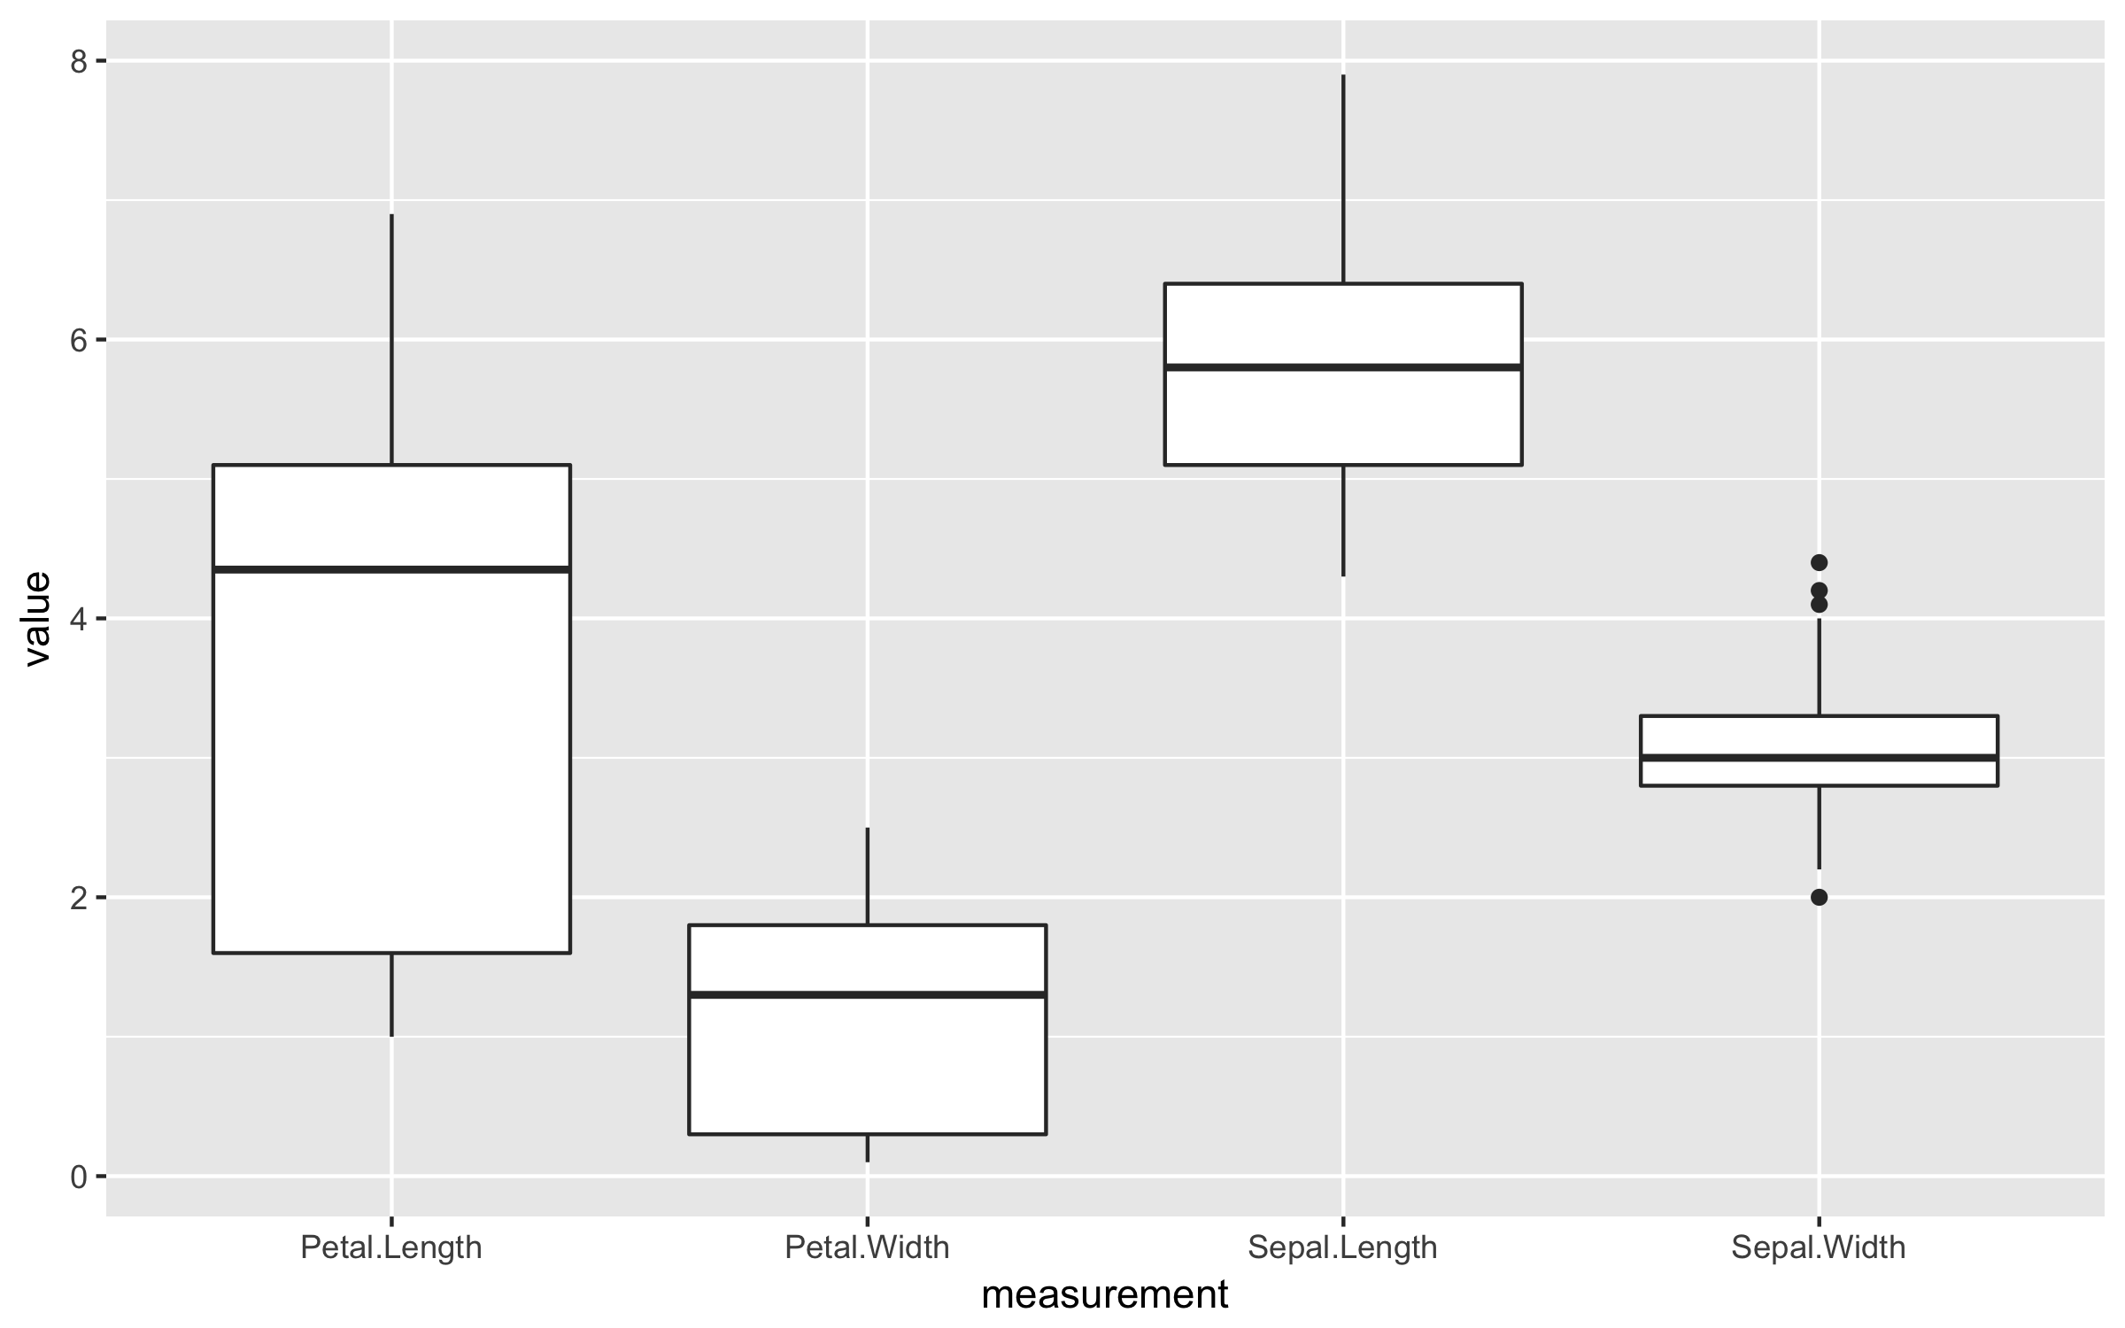
Wide vs. Long
More information per row
Combines all measurements on a single individual
Necessary to plot matching measurements
More information per column
No values as column headers (tidy)
Single observation in single row (tidy)
Necessary to plot large amounts of data in a single plot

Slide 70
Function: gather()
> iris_obs <- mutate(iris, observation = 1:n())
> iris_obs
# A tibble: 150 x 6
Sepal.Length Sepal.Width Petal.Length Petal.Width Species observation
<dbl> <dbl> <dbl> <dbl> <chr> <int>
1 5.10 3.50 1.40 0.200 setosa 1
2 4.90 3.00 1.40 0.200 setosa 2
3 4.70 3.20 1.30 0.200 setosa 3
4 4.60 3.10 1.50 0.200 setosa 4
5 5.00 3.60 1.40 0.200 setosa 5
6 5.40 3.90 1.70 0.400 setosa 6
7 4.60 3.40 1.40 0.300 setosa 7
8 5.00 3.40 1.50 0.200 setosa 8
9 4.40 2.90 1.40 0.200 setosa 9
10 4.90 3.10 1.50 0.100 setosa 10
# ... with 140 more rows
headers
content

Slide 71
Function: gather()
> iris_obs <- mutate(iris, observation = 1:n())
> iris_obs
> iris_long <- gather(iris_obs, measurement, value, Sepal.Length, Sepal.Width, Petal.Length, Petal.Width)
> iris_long
# A tibble: 600 x 4
Species observation measurement value
<chr> <int> <chr> <dbl>
1 setosa 1 Sepal.Length 5.10
2 setosa 1 Sepal.Width 3.50
3 setosa 1 Petal.Length 1.40
4 setosa 1 Petal.Width 0.200
5 setosa 2 Sepal.Length 4.90
6 setosa 2 Sepal.Width 3.00
7 setosa 2 Petal.Length 1.40
8 setosa 2 Petal.Width 0.200
9 setosa 3 Sepal.Length 4.70
10 setosa 3 Sepal.Width 3.20
# ... with 590 more rows
headers
content

Slide 72
Function: spread()
column to
headers
column to be split
as content
> iris_wide <- spread(iris_long, measurement, value)
> iris_wide
# A tibble: 150 x 6
Species observation Petal.Length Petal.Width Sepal.Length Sepal.Width
<chr> <int> <dbl> <dbl> <dbl> <dbl>
1 setosa 1 1.40 0.200 5.10 3.50
2 setosa 2 1.40 0.200 4.90 3.00
3 setosa 3 1.30 0.200 4.70 3.20
4 setosa 4 1.50 0.200 4.60 3.10
5 setosa 5 1.40 0.200 5.00 3.60
6 setosa 6 1.70 0.400 5.40 3.90
7 setosa 7 1.40 0.300 4.60 3.40
8 setosa 8 1.50 0.200 5.00 3.40
9 setosa 9 1.40 0.200 4.40 2.90
10 setosa 10 1.50 0.100 4.90 3.10
# ... with 140 more rows
necessary for grouping!

Slide 73
Exercises
Please do basic exercises 3-I and 3-II.
Time left? Opt for an optional exercise, or explore the recommended reading!

Slide 74
All done? Time to knit!

Slide 75
Introduction to R & data
Before you leave…

Slide 76
Other RDM workshops
https://www.uu.nl/en/research/research-data-management/tools-services/training-and-workshops
Learn to write your Data Management Plan (online course)
Quickstart to Research Data Management

Slide 77
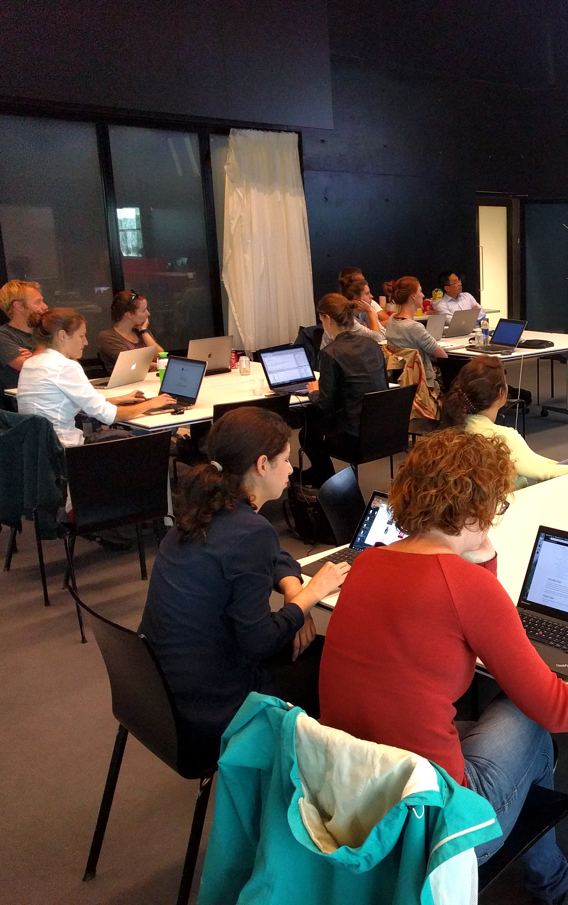
R Cafe
Monthly event for R programmers at UU/UMCU. Be part of the R community! Work on your own project, and ask (or answer!) questions.
More info on:
github.com/UtrechtUniversity/R-data-cafe
(Or subscribe to the newsletter, check the RDM support website…)
Mondays, 15-17, Bucheliuszaal (6.18) UB
Next edition: Monday 20/5, 15:00-17:00

Slide 78

We love feedback! It’s how we learn…
Please send your feedback, remarks, questions to Barbara: b.m.i.vreede@uu.nl
Or generate an issue on github!
tinyurl.com/introRData

Slide 79
useR <- function(){
print("Good luck and see you!")
}
useR()

